Slide 1

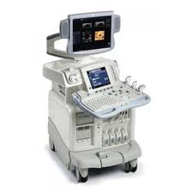
Medigreen Hospital
Now
Open
ULTRASOUND SCANNING
Waiting for the
Good News ?
We are happy to announce that our hospital now offers full-fledged Ultrasound Scanning services with the addition of Dr. John Paul, our expert radiologist on board.
We are proud to welcome Dr. John Paul to our team
Empower your health journey with advanced ultrasound diagnostics. Your well-being matters!
Every Tuesday, Thursday & Saturday
1 PM to 3 PM
EXPERTISE: Abdomen & Pelvis, Pelvis, Thyroid, Neck & Breast
FOR BOOKING : 8593959881, 0480-2861727

